Slide 1

Intelligent Search for EP/SCNO
(Enterprise Performance/Supply Chain and Network Operations)
March 2025

Slide 2
Agenda
1
Mission Statement
2
Nova Sphere
3
EP/SCNO Intelligent Search & Data Visualization AI Agent
4
Procurement Lens – Agentic Architecture
6
Future Enhancements

Slide 3




Misson Statement
Leverage AWS Sandbox: Work with the latest Gen AI services to build prototypes and identify integration points to support client work.
Refactor MVPs: Optimize existing solutions using hybrid architectures and evaluate Gen AI stack components.
Develop New Use Cases: Rapidly prototype Gen AI applications, test foundation models, and refine based on user feedback.
Support and Train: Provide reusable components, technical guidance, and hands-on learning environments for internal clients and developers.

Slide 4
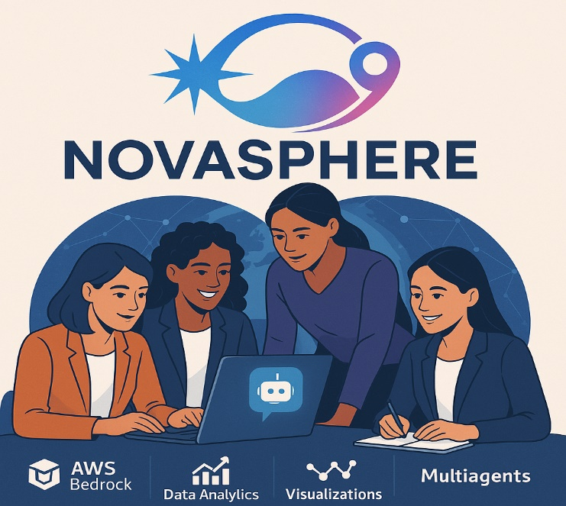
.
.
NOVA SPHERE
Nova Sphere combines innovation, female strength, and global reach through cohesive team dynamics and advanced technologies.
Innovation and Breakthrough Technology: The name "Nova" signifies new star or innovation
Female Strength and Brilliance: Inspired by stars, representing female strength and brilliance.
Cohesive Team Environment
Emphasizes a supportive and collaborative team dynamic
Global Reach: Achieved through search and GPS Technologies

Slide 5
Procurement Lens Intelligent Search & Data Visualization AI Agent
BUSINESS CHALLENGE
Procurement Lens is an existing application consisting of a series of static dashboards built in Databricks, leveraging USA spending data. While these dashboards are interactive, they lack the capability for users to request custom visualizations.
SOLUTION
To address this challenge, we are developing an Intelligent Search capability that utilizes an agent to process user queries. This agent would take a question as input, translate it into a SQL query, and generate a corresponding visualization based on the results. This solution will enhance Procurement Lens by enabling users to generate custom visualizations on demand, significantly improving interactivity and usability.
IMPACT
The Intelligent Search Agent has the following impacts:
Enhanced Decision-Making: The Intelligent Search tool transforms user queries into clear, interactive visualizations, enabling quick and informed procurement decisions.
Operational Efficiency: By automating the process of data query and visualization, the solution significantly enhances operational efficiency.
User Engagement: The ability to generate custom visualizations on demand increases user engagement and satisfaction, making the platform more interactive and user-friendly.
Scalability: The initial implementation with a single agent provides a scalable foundation, allowing for future enhancements and additional features to be integrated seamlessly.

Slide 6





















Procurement Lens – Agentic Architecture
Agentic RAG Process
User makes a query
Flask application is deployed on EC2 to handle frontend queries which in turn triggers Lambda
The lambda function creates an agent runtime and waits for a response from the agent
S3 Storage
USA Spending Data from Databricks Delta Table
Any plots or similar artifacts created by the agent are then stored to the same S3 bucket
Front End
User
Query
The flask application retrieves the agent’s response as well as any artifacts (plots, images, etc.) and is then displayed to user
USAspending Data + Metadata
Flask on EC2
Lambda
Data Ingestion | Data Queries | Knowledge Base
Bedrock
Ingesting data from Databricks Delta tables. Documents and datasets saved to S3.
+
Redshift
Knowledge bases created from Redshift and OpenSearch services.
OpenSearch
Knowledge
Base

Slide 7
User Stories
User Story - 1
As a procurement analyst,
I want to use an AI agent to visualize the top 5 awarding federal agencies with the highest total dollars obligated,
So that I can quickly identify which agencies have the largest contract obligations.
User Story - 2
As a procurement manager,
I want to use an AI agent to analyze and visualize the percentage distribution of different contract types based on contract pricing type,
So that I can understand market share and assess contractor performance.

Slide 8


Future Enhancements
AWS Caching for capturing frequently asked questions.
AWS Amplify for alternative frontend
R53 domain name
Access to users through AWS Cognito services
Access to data
Integration of AWS to MCP Databricks
Integration to USA Spending data through OpenAI schema.
Standardizing color schema of visualizations

Slide 9
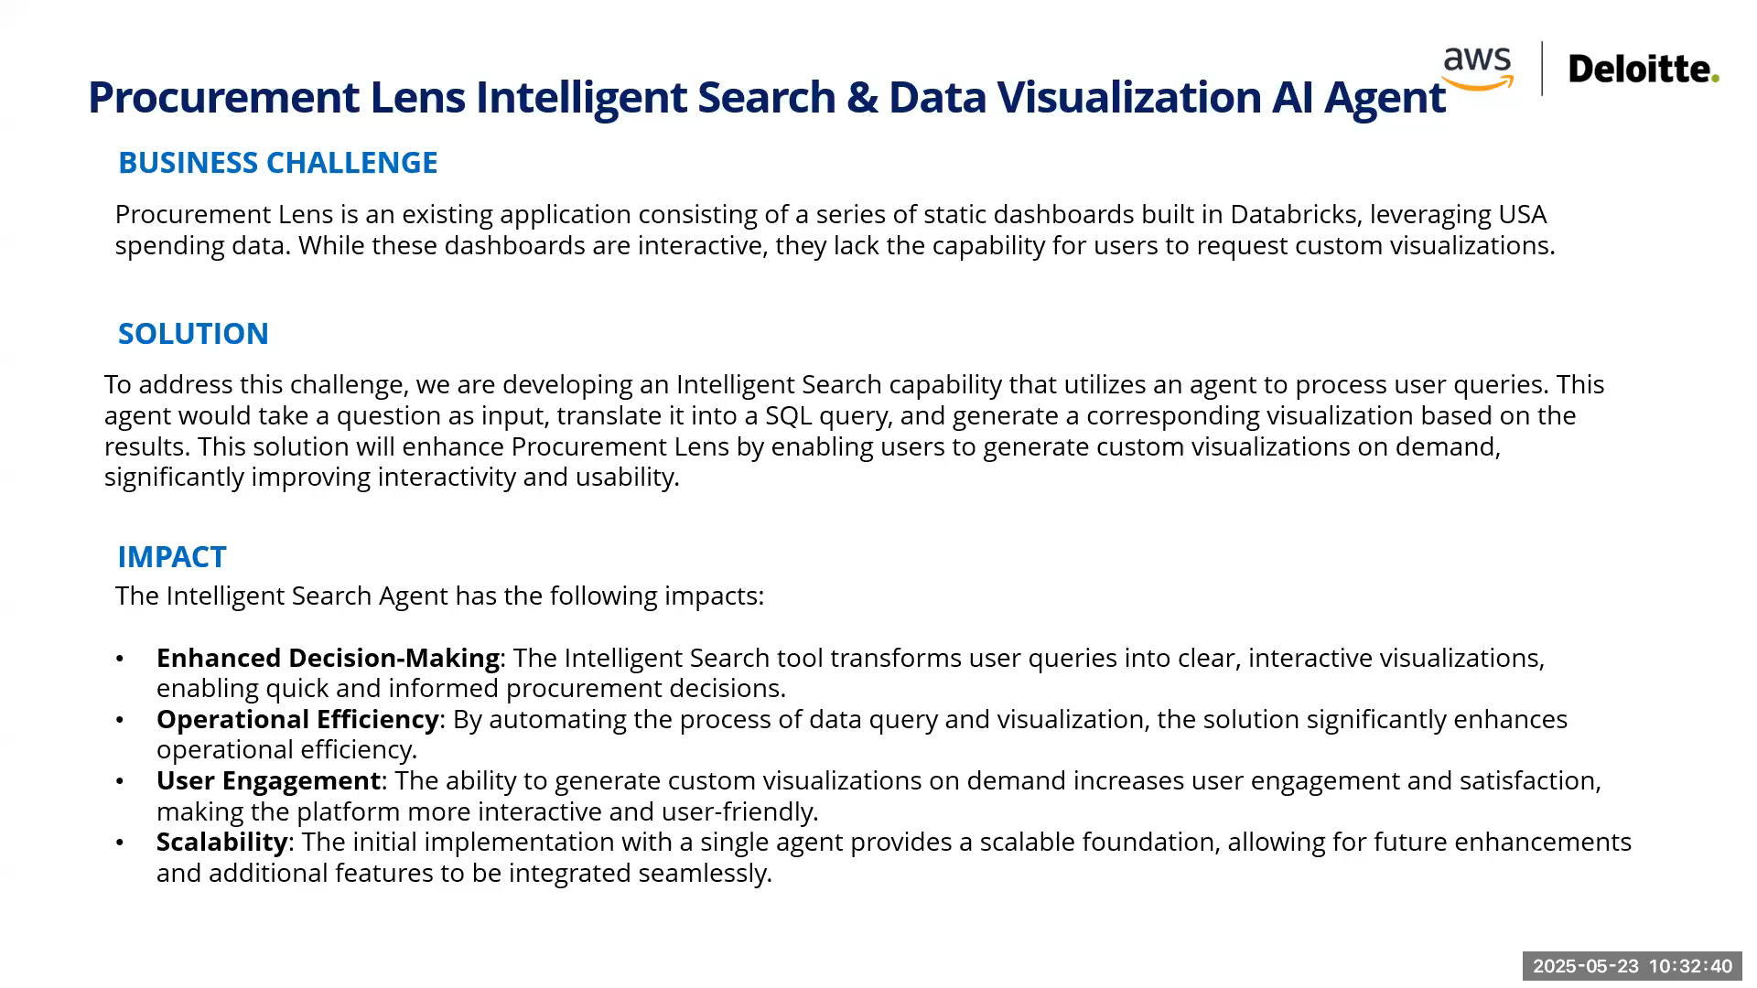
Demo Recording

Slide 10





AWS Agentic Architecture
Add redshift, data bricks, no web crawliing, metada file used. Metada – S3 bucket – refer Clinical search
Agentic RAG Process
User makes a query
Flask application is deployed on EC2 to handle frontend queries which in turn triggers Lambda
USA Spending Data
The lambda creates an agent runtime where the required files’ S3 URI is attached for analysis
Storage
Any plots or similar artifacts created by the agent are then stored to the same S3 bucket
Front End
The flask application retrieves the agent’s response as well as any artifacts (plots, images, etc.) and is then displayed to user
Flask on EC2
Lambda
Data Ingestion | Data Queries | Knowledge Base
User Query
Bedrock
Web Crawler Metadata
Documents accessed from - https://www.usaspending.gov/ and datasets saved to S3.
Knowledge Base
Metadata accessed through web crawler and uploaded to knowledge base

Slide 11
Executive Summary
PROJECT PARAMETERS
Estimated Hours: 80 hrs. (±20 hrs.)
AWS Sandbox Credits: $1,000
Architecture: AWS Bedrock Agentic Flow
Timeline: 4-6 weeks
IMPLEMENTATION PHASES
Requirements & Design: 15-20 hrs.
Development & Integration: 40-50 hrs.
Testing & Validation: 15-20 hrs.
Documentation & Handoff: 10 hrs.
KEY DELIVERABLES
Network operations anomaly detection
Performance metric dashboards and visualizations
Self-service data query capabilities.
Flask-based user interface
Serverless Lambda infrastructure
USAspending.gov data integration
Notes:
** does not include for the scaling up of the data – Databricks integration. we

Slide 12
Use-Case Timeline
WEEK 1
WEEK 2
WEEK 3
WEEK 4
WEEK 5
REQUIREMENTS ( WEEK 1- 3 )
DEVELOPMENT (2-5 Weeks)
Testing (2- 5 Weeks)
DOCUMENTATION ( 3- 5 Weeks)
DEPLOYMENT ( 3- 5 Weeks)
Notes:
Tags: timeline, months, progress

